Slide 1
Changing Paradigm of Agricultural Librarianship
Dr. Ajay P. Singh
Banaras Hindu University
Varanasi, India

Slide 2
Core Values for Librarianship
The endorsement of the principles of freedom of access to information
The belief that people, communities and organizations need universal and equitable access to information, ideas and works of imagination for their social, educational, cultural, democratic and economic well-being
The conviction that delivery of high quality library and information services helps guarantee that access
The commitment to enable all Members to engage in, and benefit from, its activities regardless citizenship, disability, ethnic origin, gender, geographical location, language, political philosophy, race or religion

Slide 3
Sustainable Development Goals
IFLA’s consistent position is that access to information is essential in achieving the SDGs
In September 2015 Member States of the United Nations adopted Transforming our world: the 2030 Agenda for Sustainable Development (UN 2030 Agenda)
By achieving this Agenda, no one will be left behind
Libraries are key institutions to help achieve the Goals.

Slide 4
Sustainable Development goals

Slide 5
GOAL 1 END POVERTY IN ALL ITS FORMS EVERYWHERE
Libraries, by providing access to information and skills, help provide opportunities for people to improve their own lives and support informed decision-making by governments, communities and others to provide services and support that reduce poverty and improve the prosperity of people everywhere.

Slide 6
GOAL 1 END POVERTY IN ALL ITS FORMS EVERYWHERE
SRI LANKA The e-Library Nenasala Programme 3 is a government-sponsored initiative to increase digital literacy and access to technology among the nation’s poorest residents, often living in remote rural areas.
300 centres in all parts of the country offer instruction in basic computer skills, guidance on accessing information through the Internet, and a wide variety of locally relevant knowledge.

Slide 7
GOAL 1 END POVERTY IN ALL ITS FORMS EVERYWHERE
Notes:
Libraries, by providing access to information and skills, help provide opportunities for people to improve their own lives and support informed decision-making by governments, communities and others to provide services and support that reduce poverty and improve the prosperity of people everywhere.

Slide 8
GOAL 2 END HUNGER, ACHIEVE FOOD SECURITY AND IMPROVED NUTRITION AND PROMOTE SUSTAINABLE AGRICULTURE
Libraries including specialist agricultural libraries and extension services provide access to research and data on crops, market information and farming methods that supports resilient, productive agriculture.

Slide 9
GOAL 2 END HUNGER, ACHIEVE FOOD SECURITY AND IMPROVED NUTRITION AND PROMOTE SUSTAINABLE AGRICULTURE
ROMANIA Librarians trained by Biblionet4 helped 100,000 farmers receive US $187 million in subsidies via new Internet and computer services between 2011 and 2014.
The 1,000+ librarians who had participated in training decided to rollout the service in libraries with the support of local mayors who understood the benefits that this service brought to farmers.
The programme helped farmers learn how to use the technology available in libraries to access financial forms and submit them to the government, saving time and money. Special attention was paid to local needs in order to guarantee take-up.

Slide 10
GOAL 2 Zero Hunger
Notes:
Libraries including specialist agricultural libraries and extension services provide access to research and data on crops, market information and farming methods that supports resilient, productive agriculture.

Slide 11
GOAL 3: ENSURE HEALTHY LIVES AND PROMOTE WELLBEING FOR ALL AT ALL AGES
Medical libraries, hospital libraries and other libraries are essential providers of access to medical research that supports improved public health outcomes.
Public access to health information in all libraries helps people to be better informed about their own health and to stay healthy.

Slide 12
GOAL 3 Healthy Lives

Slide 13
GOAL 4: ENSURE INCLUSIVE AND EQUITABLE QUALITY EDUCATION AND PROMOTE LIFELONG LEARNING OPPORTUNITIES FOR ALL
Libraries are at the heart of schools, universities and colleges in every country around the world.
Libraries support literacy programmes, provide a safe space for learning, and support researchers to reuse research and data to create new knowledge.

Slide 14
GOAL 4: ENSURE INCLUSIVE AND EQUITABLE QUALITY EDUCATION AND PROMOTE LIFELONG LEARNING OPPORTUNITIES FOR ALL
NETHERLANDS Boekstart 8 works with day care and healthcare centres, public libraries and the first two years of primary school to provide books and literacy training to 75,000 children aged 0-4 per year.
The programme is supported by national and local government, and aims to establish long-term collaboration between organisations that support children’s literacy.

Slide 15
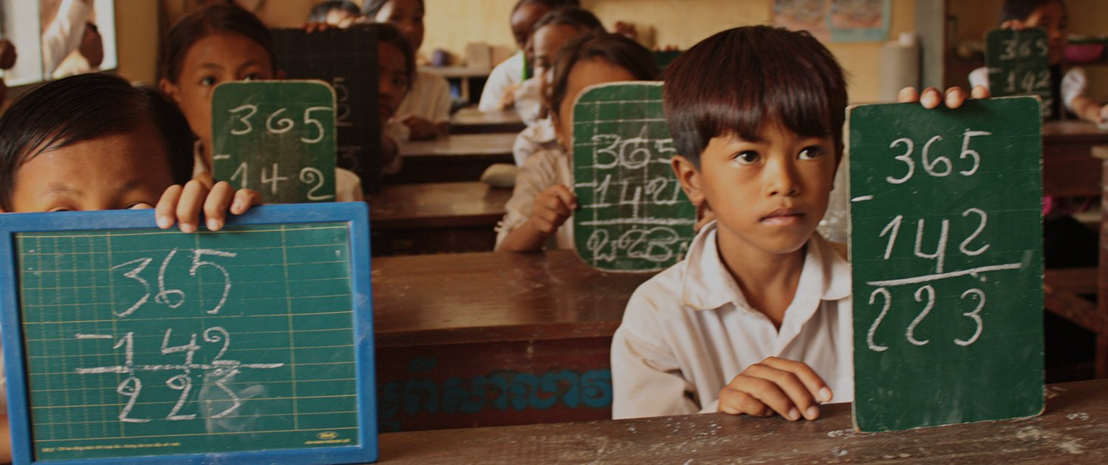
Goal 4 Quality Education

Slide 16
GOAL 5 : ACHIEVE GENDER EQUALITY AND EMPOWER ALL WOMEN AND GIRLS
Libraries support gender equality by providing safe meeting spaces, programmes for women and girls on rights and health, and ICT and literacy programmes support women to build their entrepreneurial skills.

Slide 17
GOAL 5 : ACHIEVE GENDER EQUALITY AND EMPOWER ALL WOMEN AND GIRLS
NEPAL READ’s (Rural Education and Development) Information and Resource Centre’s Capacity-building Initiative helps women and girls gain insights and take control of their own lives.
The empowerment programme includes seminars and workshops on women’s rights, gender equality, health, violence against women and other issues.
The library encourages women to sign up for the women’s group, which meets once a month in a separate section of the library where its members feel free to speak their minds.
Practical courses include literacy and numeracy, English language, ICT, entrepreneurship skills and hands-on classes in making goods for sale.

Slide 18
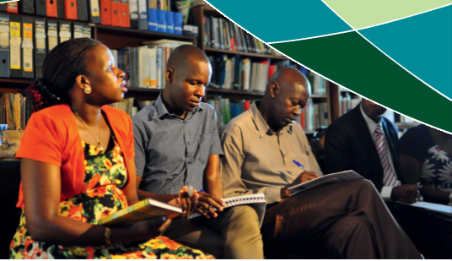
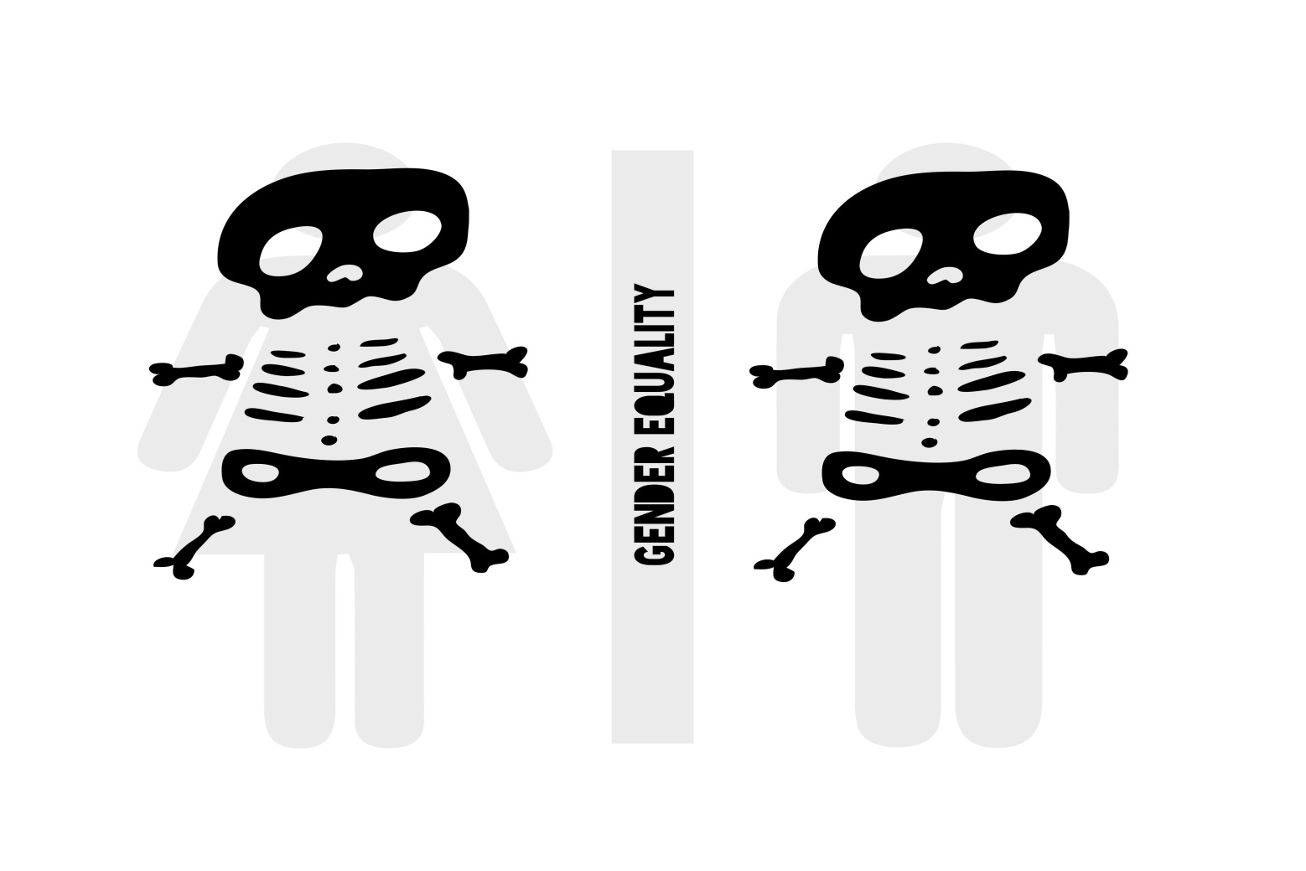
GOAL 5 : ACHIEVE GENDER EQUALITY AND EMPOWER ALL WOMEN AND GIRLS

Slide 19
GOAL 17: STRENGTHEN THE MEANS OF IMPLEMENTATION AND REVITALIZE THE GLOBAL PARTNERSHIP FOR SUSTAINABLE DEVELOPMENT
CANADA The National Science Library at the National Research Council is a co-sponsor of the Federal Science Library – a project bringing together seven federal science department libraries to create a single shared discovery and access platform.
This aims to guarantee more sustainable library and information services for federal government researchers and employees and to enhance visibility and access to federal science library collections and repositories for Canadians.

Slide 21
SDGs
Goal 4
ENSURE INCLUSIVE AND EQUITABLE QUALITY EDUCATION AND PROMOTE LIFELONG LEARNING OPPORTUNITIES FOR ALL
Goal 5
ACHIEVE GENDER EQUALITY AND EMPOWER ALL WOMEN AND GIRLS
Goal 6
ENSURE AVAILABILITY AND SUSTAINABLE MANAGEMENT OF WATER AND SANITATION FOR ALL

Slide 22
SDGs
Goal 7
ENSURE ACCESS TO AFFORDABLE, RELIABLE, SUSTAINABLE AND MODERN ENERGY FOR ALL
Goal 8
PROMOTE SUSTAINED, INCLUSIVE AND SUSTAINABLE ECONOMIC GROWTH, FULL AND PRODUCTIVE EMPLOYMENT AND DECENT WORK FOR ALL PUBLIC
Goal 9
BUILD RESILIENT INFRASTRUCTURE, PROMOTE SUSTAINABLE INDUSTRIALIZATION AND FOSTER INNOVATION

Slide 23
SDGs
Goal 10
REDUCE INEQUALITY WITHIN AND AMONG COUNTRIES
Goal 11
MAKE CITIES AND HUMAN SETTLEMENTS INCLUSIVE, SAFE, RESILIENT AND SUSTAINABLE
Goal 12
ENSURE SUSTAINABLE CONSUMPTION AND PRODUCTION PATTERNS GOAL

Slide 24
SDGs
Goal 13
TAKE URGENT ACTION TO COMBAT CLIMATE CHANGE AND ITS IMPACTS
Goal 14
CONSERVE AND SUSTAINABLY USE THE OCEANS, SEAS AND MARINE RESOURCES FOR SUSTAINABLE DEVELOPMENT
Goal 15
PROTECT, RESTORE AND PROMOTE SUSTAINABLE USE OF TERRESTRIAL ECOSYSTEMS, SUSTAINABLY MANAGE FORESTS, COMBAT DESERTIFICATION, AND HALT AND REVERSE LAND DEGRADATION AND HALT BIODIVERSITY LOSS

Slide 25
SDGs
Goal 16
PROMOTE PEACEFUL AND INCLUSIVE SOCIETIES FOR SUSTAINABLE DEVELOPMENT, PROVIDE ACCESS TO JUSTICE FOR ALL AND BUILD EFFECTIVE, ACCOUNTABLE AND INCLUSIVE INSTITUTIONS AT ALL LEVELS
Goal 17
STRENGTHEN THE MEANS OF IMPLEMENTATION AND REVITALIZE THE GLOBAL PARTNERSHIP FOR SUSTAINABLE DEVELOPMENT

Slide 26
The International Advocacy Programme (IAP)
IFLA launched the International Advocacy Programme (IAP) in 2016
capacity-building programme designed to promote and support the role libraries can play in the planning and implementation of the UN 2030 Agenda and the SDGs

Slide 27
The International Advocacy Programme (IAP)
The objectives of the IAP are to:
Raise the level of awareness on the SDGs of library workers at community, national and regional levels, and to promote the important role libraries can play in development by contributing to the UN 2030 Agenda and the SDGs;
Increase the participation of library associations and public library representatives in advocacy work at national and regional levels to secure sustainable public access to information through library services and programmes.

